Slide 1

Hostel Management System
_
×
Welcome to NSBM
Hostel Management System
Username
Password
Forgot password?
Login
Close
Don't have an account?
Sign up

Slide 2
Hostel Management System
_
×
Welcome to NSBM
Hostel Management System
Enter a valid username
Enter a valid password
Username or password is incorrect!
Forgot password?
Login
Close
Don't have an account?
Sign up

Slide 3
Hostel Management System
_
×
Forgot password
Please enter your username and email and we will send you instructions on how to reset your password
Username
Email
Submit

Slide 4


Hostel Management System
_
×
Forgot password
Please enter your username and email and we will send you instructions on how to reset your password
Devika
devika@gmail.com
Submit

Slide 5

Hostel Management System
_
×
Sign Up – Step 3
Instructions on resetting the password has been sent to you. Check you mailbox
Ok

Slide 6
Hostel Management System
_
×
Sign Up – Step 1
Enter your ID
Verify
Back

Slide 7
Hostel Management System
_
×
Sign Up – Step 1
Enter your ID
SBM-STaFF-001
Verify
Back

Slide 8

Hostel Management System
_
×
Sign Up – Step 1
ID you entered is not valid!
Enter your ID
Verify
Back

Slide 9
Hostel Management System
_
×
Sign Up – Step 1
Enter your ID
NSBM-STAFF-001
Verify
Back

Slide 10
Hostel Management System
_
×
Sign Up – Step 2
Enter your ID
NSBM-STAFF-001
Username
Email
Password
Re-Password
Sign In
Back

Slide 11
Hostel Management System
_
×
Logout
Sign Up – Step 3
You have created your account successfully
Continue

Slide 12
Hostel Management System
_
×
Welcome to NSBM
Hostel Management System
Devika
Devika123
Username or password is incorrect!
Forgot password?
Login
Close
Don't have an account?
Sign up

Slide 13
Hostel Management System
_
×
Logout
Registrations
Mark In/Out
Monthly Payments
Make Complaints
Make Reports

Slide 14

Hostel Management System
_
×
Logout
Student Registration Form
Applicant Details
Upload Photo
First Name
Last Name
Degree Programme
UGC MIS
Date of Birth
8/7/2012
Gender
Male
Female
NIC Number
Passport
Required only if there is no NIC
Nationality
Sinhala
Religion
Buddhist
Mother Tongue
Sinhala
Permanent Address
Email
Contact Number
+94
Continue
Cancel

Slide 15

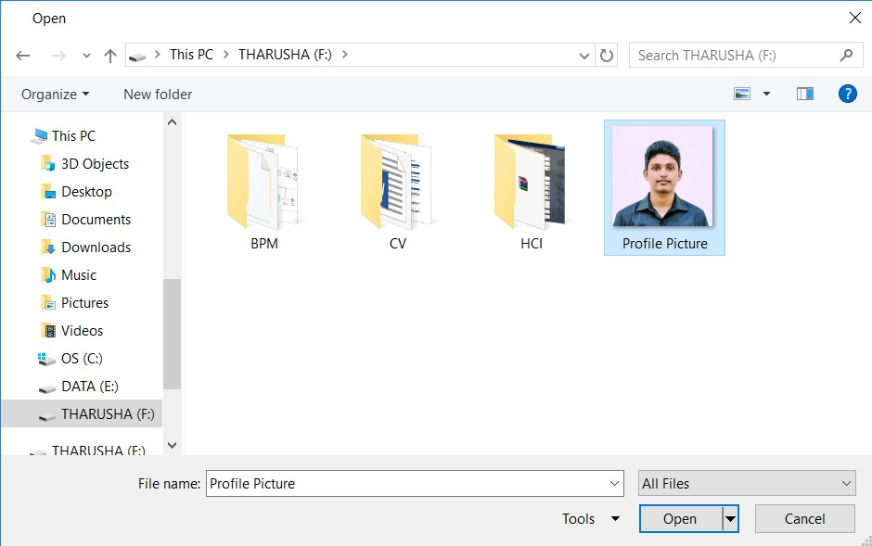
Hostel Management System
_
×
Logout
Student Registration Form
Applicant Details
Upload Photo
First Name
Last Name
Degree Programme
UGC MIS
Date of Birth
8/7/2012
Gender
Male
Female
NIC Number
Passport
Required only if there is no NIC
Nationality
Sinhala
Religion
Buddhist
Mother Tongue
Sinhala
Permanent Address
Upload
Email
Contact Number
+94
Continue
Cancel

Slide 16
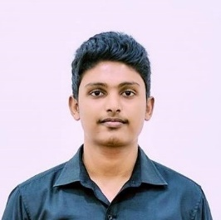
Hostel Management System
_
×
Logout
Student Registration Form
Applicant Details
Upload Photo
First Name
Last Name
Degree Programme
UGC MIS
Date of Birth
8/7/2012
Gender
Male
Female
NIC Number
Passport
Required only if there is no NIC
Nationality
Sinhala
Religion
Buddhist
Mother Tongue
Sinhala
Permanent Address
Email
Contact Number
+94
Continue
Cancel

Slide 17

Hostel Management System
_
×
Logout
Student Registration Form
Applicant Details
Upload Photo
First Name
Last Name
Degree Programme
UGC MIS
UGC MIS
Date of Birth
UGC MIS
8/7/2012
UCD CS
Gender
UCD CS
Male
Female
Plymouth Networking
Plymouth Networking
Plymouth SE
NIC Number
Plymouth SE
Passport
Required only if there is no NIC
Nationality
Sinhala
Religion
Buddhist
Mother Tongue
Sinhala
Permanent Address
Email
Contact Number
+94
Continue
Cancel

Slide 18
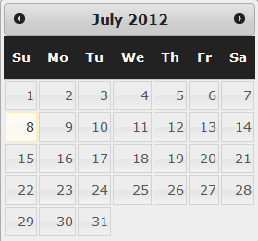
Hostel Management System
_
×
Logout
Student Registration Form
Applicant Details
Upload Photo
First Name
Last Name
Degree Programme
UGC MIS
Date of Birth
8/7/2012
Gender
Male
Female
NIC Number
Passport
Required only if there is no NIC
Nationality
Sinhala
Religion
Buddhist
Mother Tongue
Sinhala
Permanent Address
Email
Contact Number
+94
Continue
Cancel

Slide 19
Hostel Management System
_
×
Logout
Student Registration Form
Applicant Details
Upload Photo
First Name
Last Name
Degree Programme
UGC MIS
Date of Birth
8/7/2012
Gender
Male
Female
NIC Number
Passport
Required only if there is no NIC
Nationality
Sinhala
Religion
Buddhist
Mother Tongue
Sinhala
Permanent Address
Email
Contact Number
+94
Continue
Cancel

Slide 20
Hostel Management System
_
×
Logout
Student Registration Form
Applicant Details
Upload Photo
First Name
Last Name
Degree Programme
UGC MIS
UGC MIS
Date of Birth
UGC MIS
8/7/2012
UCD CS
Gender
UCD CS
Male
Female
Plymouth Networking
Plymouth Networking
Plymouth SE
NIC Number
Plymouth SE
Passport
Required only if there is no NIC
Nationality
Sinhala
Religion
Buddhist
Mother Tongue
Sinhala
Permanent Address
Email
Contact Number
+94
Continue
Cancel

Slide 21
Hostel Management System
_
×
Logout
Student Registration Form
Applicant Details
Upload Photo
First Name
Last Name
Degree Programme
UGC MIS
Date of Birth
8/7/2012
Gender
Male
Female
NIC Number
Passport
Required only if there is no NIC
Nationality
Sinhala
Religion
Buddhist
Mother Tongue
Sinhala
Permanent Address
Email
Contact Number
+94
Continue
Cancel

Slide 22
Hostel Management System
_
×
Logout
Student Registration Form
Applicant Details
Upload Photo
First Name
Last Name
Degree Programme
UGC MIS
Date of Birth
8/7/2012
Gender
Male
Female
NIC Number
Passport
Required only if there is no NIC
Nationality
Sinhala
Sinhala
Religion
Buddhist
Tamil
Mother Tongue
Sinhala
Muslim
Permanent Address
Burger
Other
Email
Contact Number
+94
Continue
Cancel

Slide 23
Hostel Management System
_
×
Logout
Student Registration Form
Applicant Details
Upload Photo
First Name
Last Name
Degree Programme
UGC MIS
Date of Birth
8/7/2012
Gender
Male
Female
NIC Number
Passport
Required only if there is no NIC
Nationality
Sinhala
Sinhala
Religion
Buddhist
Tamil
Mother Tongue
Sinhala
Muslim
Permanent Address
Burger
Other
Email
Contact Number
+94
Continue
Cancel

Slide 24
Hostel Management System
_
×
Logout
Student Registration Form
Applicant Details
Upload Photo
First Name
Last Name
Degree Programme
UGC MIS
Date of Birth
8/7/2012
Gender
Male
Female
NIC Number
Passport
Required only if there is no NIC
Nationality
Sinhala
Religion
Buddhist
Buddhist
Mother Tongue
Sinhala
Permanent Address
Hindu
Catholic / Christian
Email
Islamic
Contact Number
Other
+94
Continue
Cancel

Slide 25
Hostel Management System
_
×
Logout
Student Registration Form
Applicant Details
Upload Photo
First Name
Last Name
Degree Programme
UGC MIS
Date of Birth
8/7/2012
Gender
Male
Female
NIC Number
Passport
Required only if there is no NIC
Nationality
Sinhala
Religion
Buddhist
Buddhist
Mother Tongue
Sinhala
Permanent Address
Hindu
Catholic / Christian
Email
Islamic
Contact Number
Other
+94
Continue
Cancel

Slide 26
Hostel Management System
_
×
Logout
Student Registration Form
Applicant Details
Upload Photo
First Name
Last Name
Degree Programme
UGC MIS
Date of Birth
8/7/2012
Gender
Male
Female
NIC Number
Passport
Required only if there is no NIC
Nationality
Sinhala
Religion
Buddhist
Mother Tongue
Sinhala
Permanent Address
Sinhala
Tamil
Email
English
Contact Number
Other
+94
Continue
Cancel

Slide 27
Hostel Management System
_
×
Logout
Student Registration Form
Applicant Details
Upload Photo
First Name
Last Name
Degree Programme
UGC MIS
Date of Birth
8/7/2012
Gender
Male
Female
NIC Number
Passport
Required only if there is no NIC
Nationality
Sinhala
Religion
Buddhist
Mother Tongue
Sinhala
Permanent Address
Sinhala
Tamil
Email
English
Contact Number
Other
+94
Continue
Cancel

Slide 28
Hostel Management System
_
×
Logout
Student Registration Form
Parent/Guardian Details
First Name
Last Name
Occupation
Permanent Address
Email
Contact Number
SL +94
Registration Fee
Payment Method
Cash
Debit/Credit Card
Register
Back

Slide 29
Hostel Management System
_
×
Logout
Student Registration Form
Parent/Guardian Details
First Name
Last Name
Occupation
Permanent Address
Email
Contact Number
SL +94
SL
USA
Registration Fee
IND
Payment Method
Cash
Debit/Credit Card
Register
Back

Slide 30
Hostel Management System
_
×
Logout
Student Registration Form
Parent/Guardian Details
First Name
Last Name
Occupation
Permanent Address
Email
Contact Number
SL +94
SL
USA
Registration Fee
IND
Payment Method
Cash
Debit/Credit Card
Register
Back

Slide 31
Hostel Management System
_
×
Logout
Student Registration Form
Parent/Guardian Details
First Name
Last Name
Occupation
Permanent Address
Email
Contact Number
SL +94
Registration Fee
Payment Method
Cash
Debit/Credit Card
Register
Back

Slide 32
Hostel Management System
_
×
Logout
Tharusha’s registration has been Completed successfully
Student ID – BSC-UGC-MIS-16.1-017
Ok

Slide 33
Hostel Management System
_
×
Logout
Mark In/Out
Enter Student’s ID
Verify
Back

Slide 34
Hostel Management System
_
×
Logout
Mark In/Out
Enter Student’s ID
BSC-UGC-MIS-16.1-004
Verify
Back

Slide 35
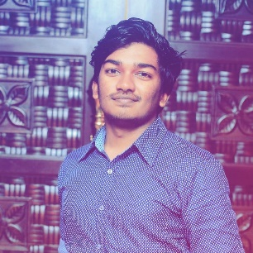
Hostel Management System
_
×
Logout
Mark In/Out
Diyath Abeywickrema
Student ID
BSC-UGC-MIS-16.1-004
Degree Programme
UGC MIS
Select
In
Out
Purpose to Leave
Ok
Cancel

Slide 36
Hostel Management System
_
×
Logout
Diyath’s mark-in has been
recorded successfully
Ok

Slide 37
Hostel Management System
_
×
Logout
Mark In/Out
Diyath Abeywickrema
Student ID
BSC-UGC-MIS-16.1-004
Degree Programme
UGC MIS
Select
In
Out
Purpose to Leave
Ok
Cancel

Slide 38
Hostel Management System
_
×
Logout
Diyath’s mark-out has been
recorded successfully
Ok

Slide 39
Hostel Management System
_
×
Logout
Monthly Payments
Enter Student’s ID
Verify
Back

Slide 40
Hostel Management System
_
×
Logout
Monthly Payments
Enter Student’s ID
BSC-UGC-MIS-16.1-047
Verify
Back

Slide 41
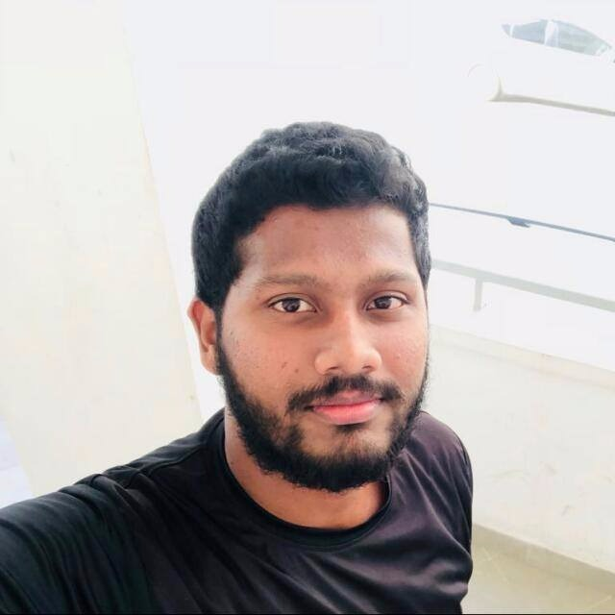
Hostel Management System
_
×
Logout
Monthly Payments
Aviresh Uddeepa Wickramarachchi
Student ID
BSC-UGC-MIS-16.1-047
Degree Programme
UGC MIS
Hostel Period
April 2017
to
April 2018
Last Payment
December 2017
Due Month
January 2018
Total Amount
Rs.
Payment Method
Cash
Credit/Debit
Ok
Cancel

Slide 42
Hostel Management System
_
×
Logout
Monthly Payments
Aviresh Uddeepa Wickramarachchi
Student ID
BSC-UGC-MIS-16.1-047
Degree Programme
UGC MIS
Hostel Period
April 2017
to
April 2018
Last Payment
December 2017
Due Month
January 2018
January 2018
Total Amount
February 2018
Rs.
March 2018
Payment Method
April 2018
Cash
Credit/Debit
Ok
Cancel

Slide 43
Hostel Management System
_
×
Logout
Monthly Payments
Aviresh Uddeepa Wickramarachchi
Student ID
BSC-UGC-MIS-16.1-047
Degree Programme
UGC MIS
Hostel Period
April 2017
to
April 2018
Last Payment
December 2017
Due Month
January 2018
Total Amount
Rs.
Payment Method
Cash
Credit/Debit
Ok
Cancel

Slide 44
Hostel Management System
_
×
Logout
Aviresh’s monthly payment has been recorded successfully
Ok

Slide 45
Hostel Management System
_
×
Logout
Make Complaints
Enter Student’s ID
Verify
Back

Slide 46
Hostel Management System
_
×
Logout
Make Complaints
Enter Student’s ID
BSC-UGC-MIS-16.1-004
Verify
Back

Slide 47
Hostel Management System
_
×
Logout
Make Complaints
Diyath Abeywickrema
Student ID
BSC-UGC-MIS-16.1-004
Degree Programme
UGC MIS
Room Number
0012
Select Category
Electricity
Complaint
Ok
Cancel

Slide 48
Hostel Management System
_
×
Logout
Make Complaints
Diyath Abeywickrema
Student ID
BSC-UGC-MIS-16.1-004
Degree Programme
UGC MIS
Room Number
0012
Select Category
Electricity
Electricity
Complaint
Water
Other
Continue
Ok
Cancel
Cancel

Slide 49
Hostel Management System
_
×
Logout
Diyath’s complaint has been recorded successfully
Ok

Slide 50
Hostel Management System
_
×
Logout
Make Reports
Select your Category
Student ID
Payments only
IN/OUT
All
According to date
to
Payments only
IN/OUT
Registration
All
Continue
Generate
Cancel
Cancel

Slide 51
Hostel Management System
_
×
Logout
Make Reports
Report of Payments of BSC-UGC-MIS-047, Aviresh
Continue
Print
Cancel
Back

Slide 52
Hostel Management System
_
×
Logout
Make Reports
Select your Category
Student ID
Payments only
IN/OUT
All
According to date
to
Payments only
IN/OUT
Registration
All
Continue
Generate
Cancel
Cancel

Slide 53
Hostel Management System
_
×
Logout
Make Reports
Report of Payments from 2018 Jan to 2018 Dec
Continue
Print
Cancel
Back

